Slide 1
The Implementation of Gamification Elements in a Learning VR Environment
Jake Zammit – MCAST, IICT

Slide 2
Background & Rationale
Gamification in education
VR in learning:
Gap
Increases motivation
engagement
Immersive experience
hands-on approach
Limited studies combining both

Slide 3
Research Aim & Questions
Aim: Explore how gamified VR affects engagement and knowledge retention
Key Questions:
Does gamification increase engagement in VR?
Does it improve knowledge retention?
Which elements are most effective?

Slide 4
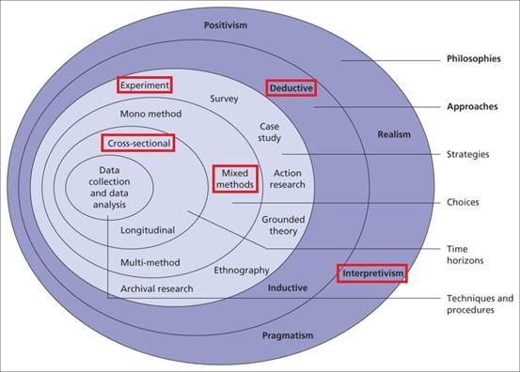
Reserach Onion

Slide 5
Methodology
Approach: Mixed-methods (qualitative + quantitative)
Tools:
Pre-/post-quizzes
Engagement surveys
Semi-structured interviews
Participants: 7 users tested the VR prototype
Prototype: Unity-based VR app—space station, planet selection, travel, quizzes

Slide 6
Key Findings
Engagement:
Avg. rating: 4.6/5
Cinematic transitions and sound feedback rated highest
Knowledge Retention:
Pre-test avg: 63%
Post-test avg: 89%
Participant quote: “The warping to different planets was very satisfying.”

Slide 7
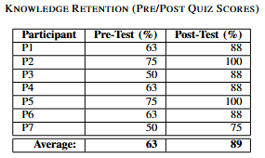
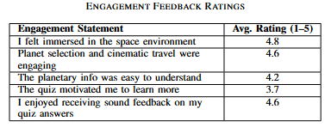
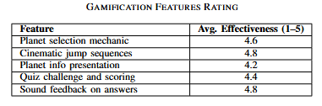

Slide 8
Future Work and Improvements
Limitations:
Small sample size
Short-term measurement
Next Steps:
Add leaderboards and missions
Test with a larger group
Measure long-term retention

Slide 9
Conclusion
Gamification + VR = Effective educational tool
Supports Constructivist and Self-Determination theories

Slide 10
Thankyou
Jake Zammit
Email: jake.zammit.d57298@mcast.edu.mt

